Slide 1
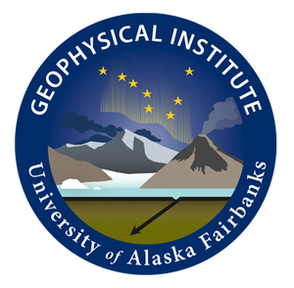

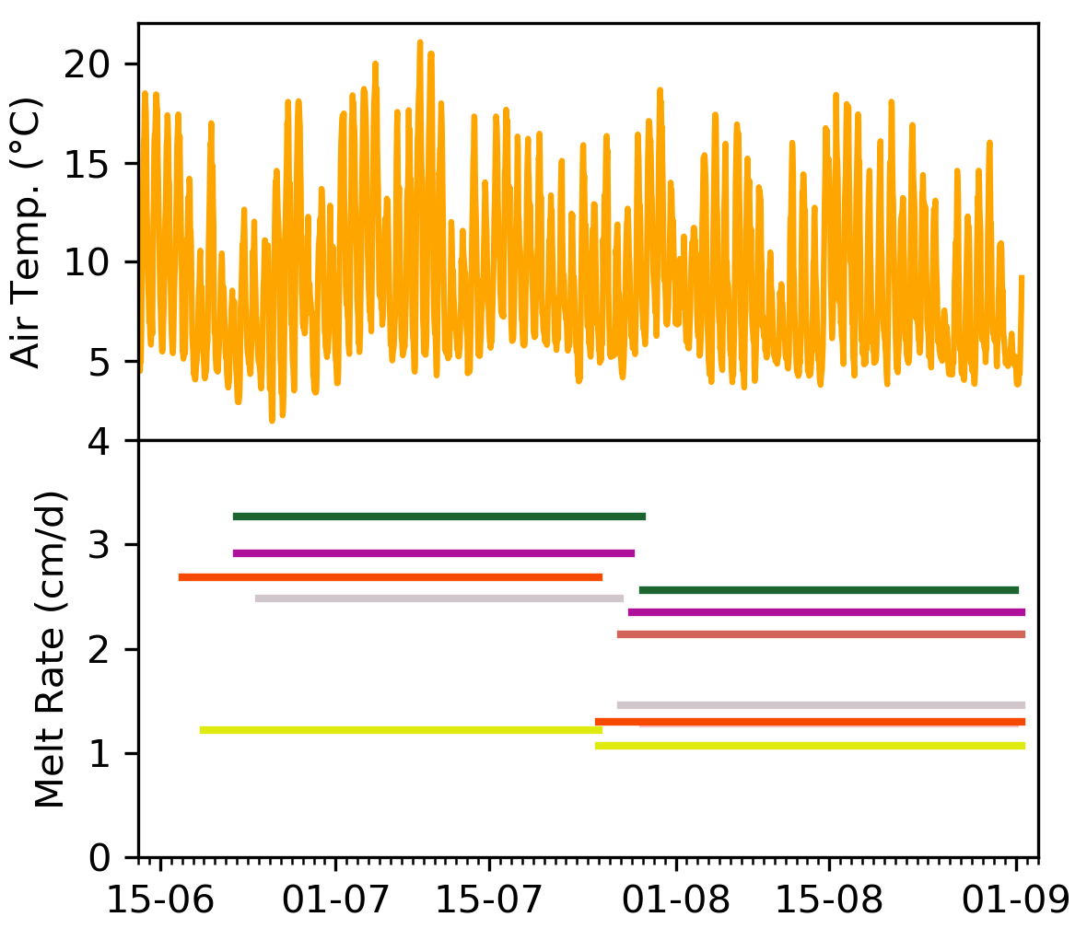
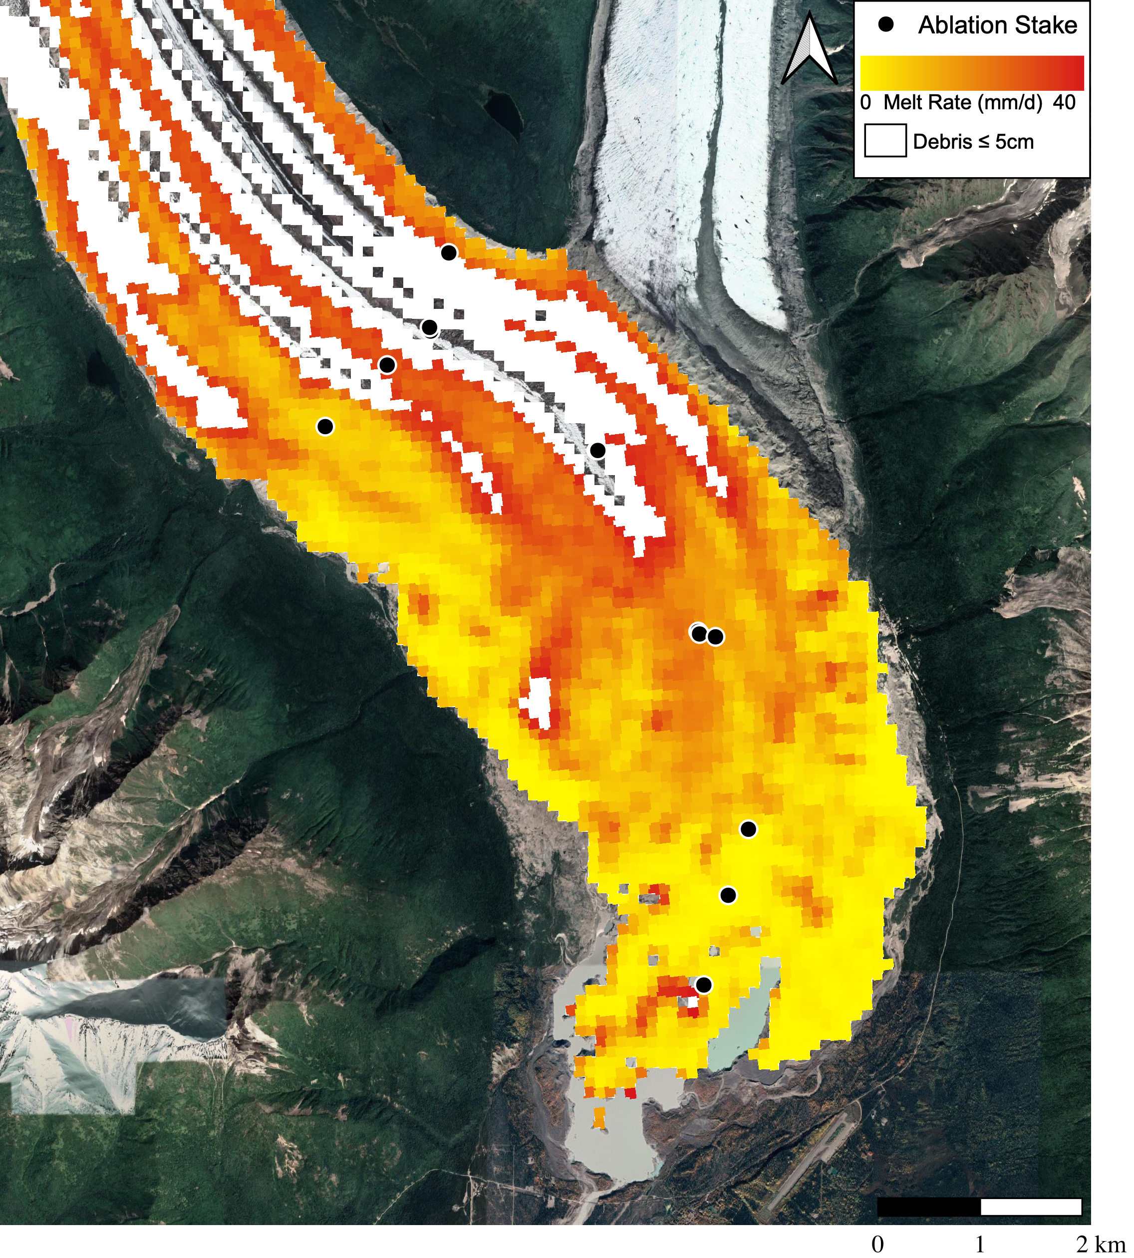
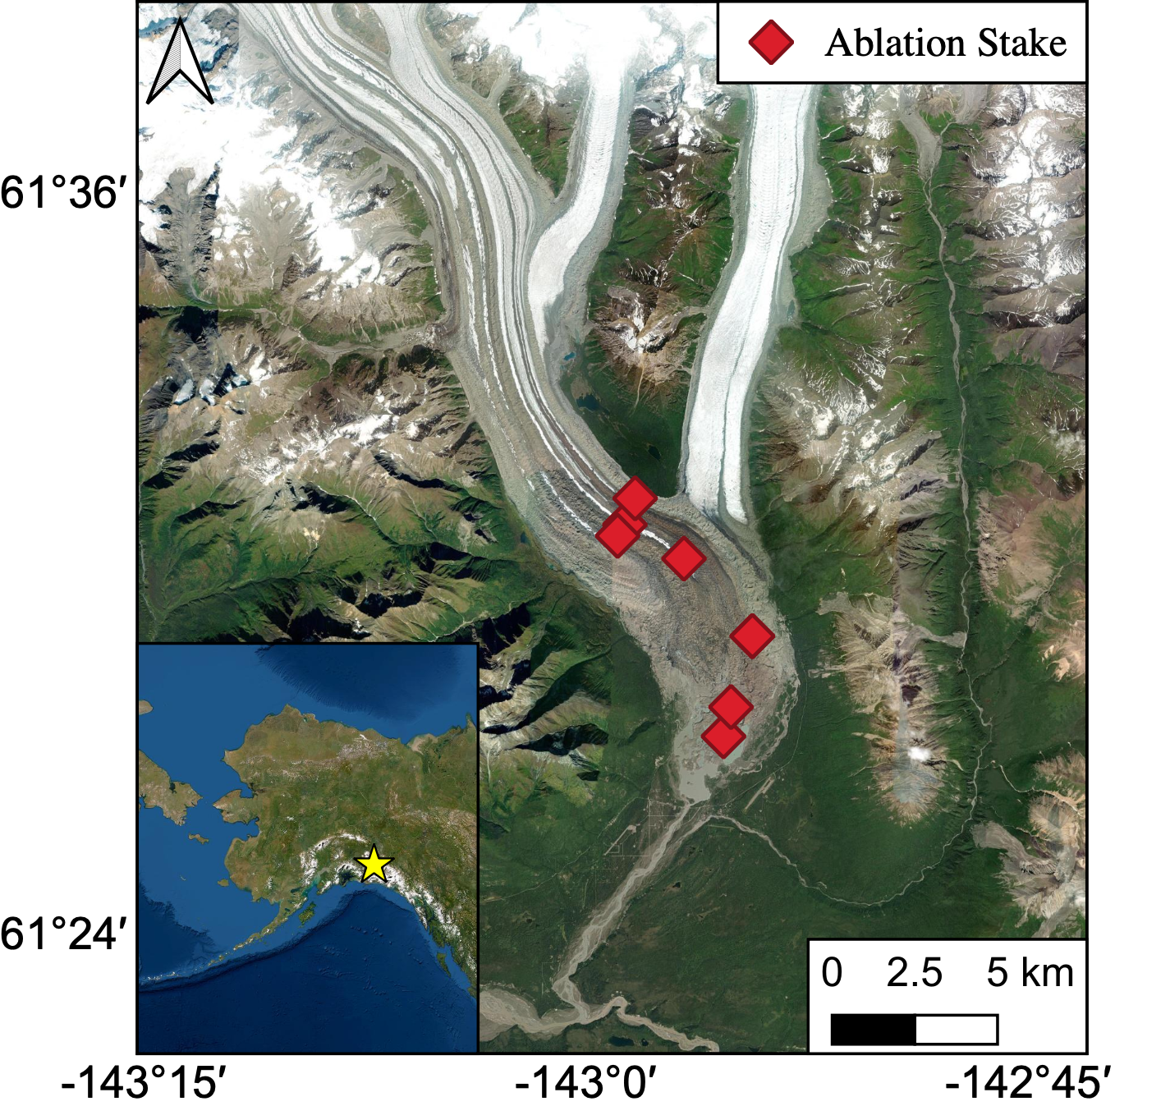
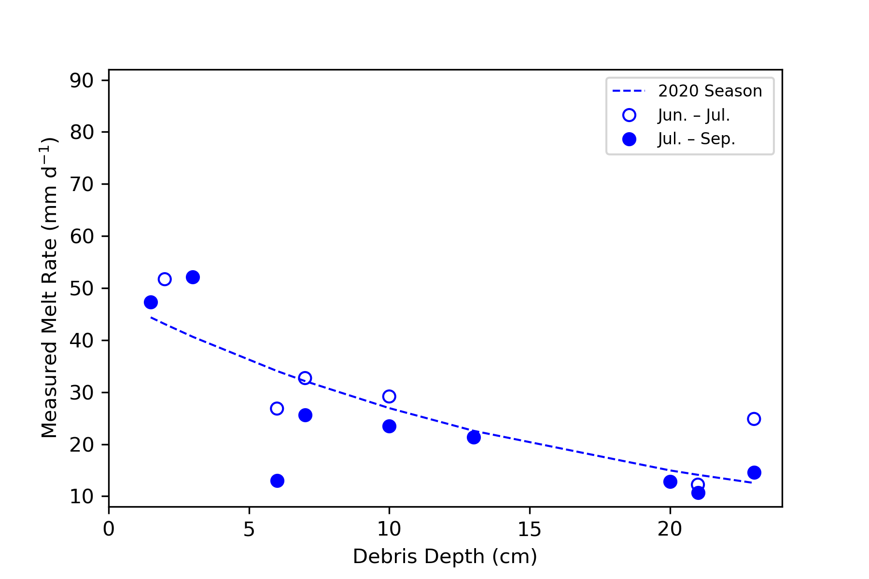
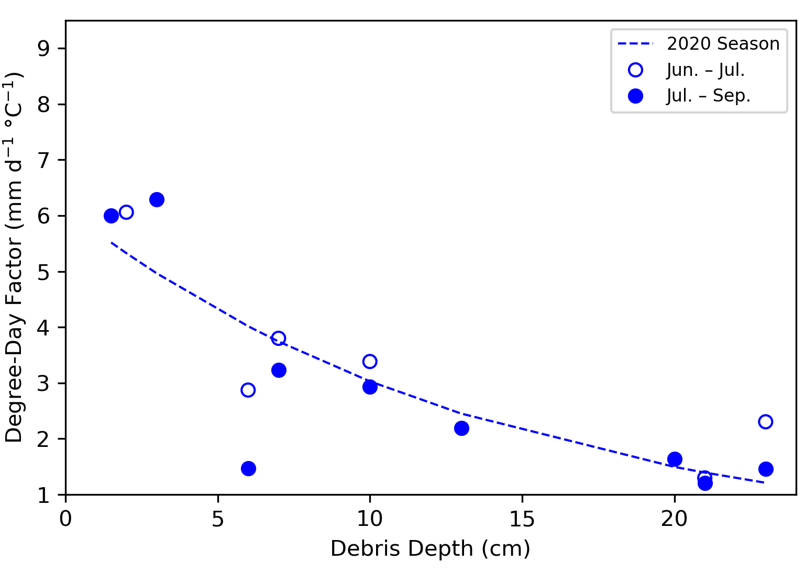
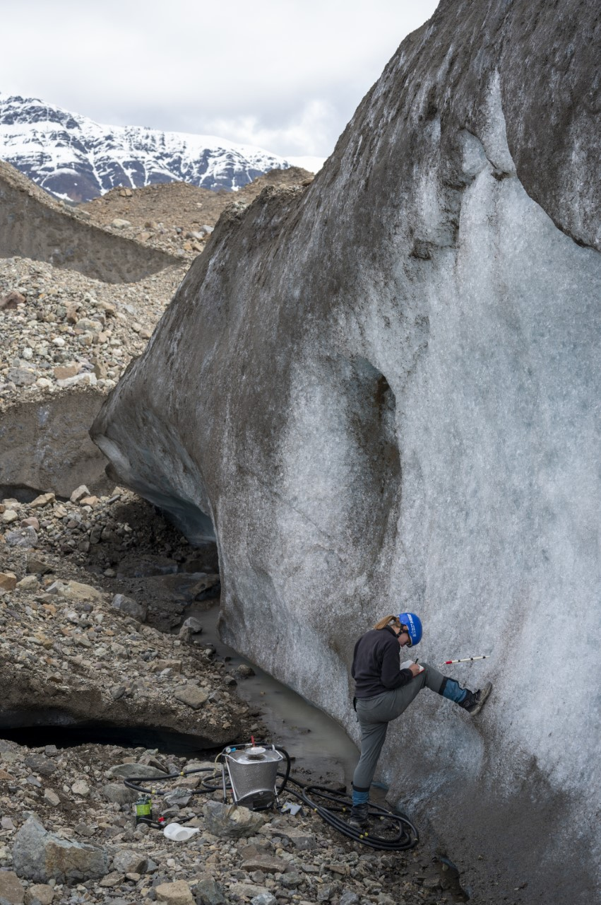
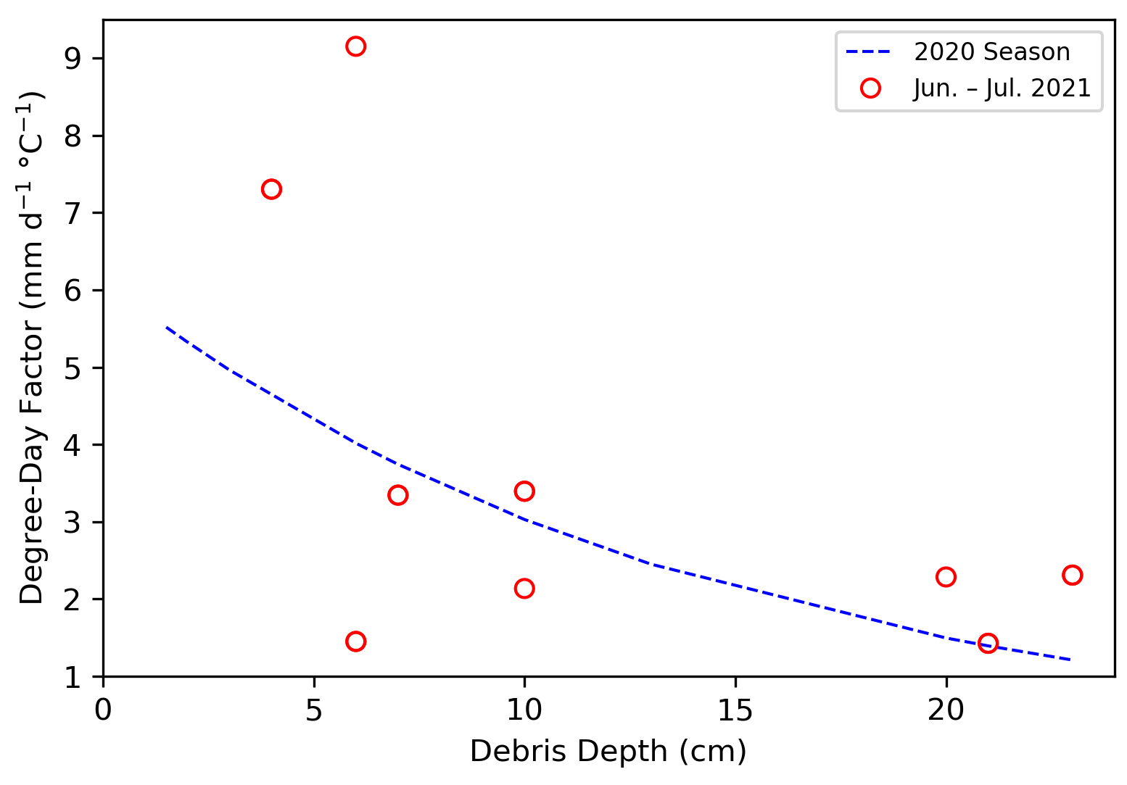
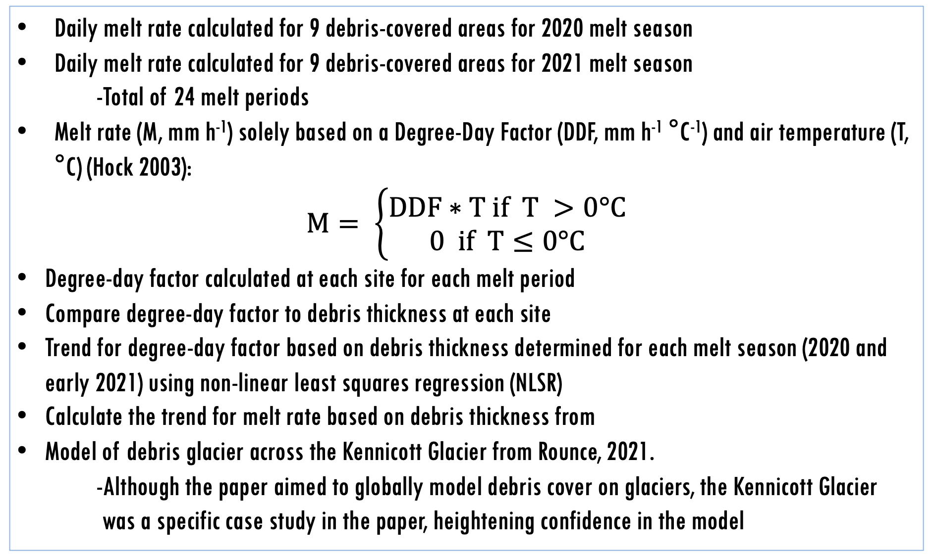
A degree-day model incorporating debris thickness for the
Kennicott Glacier, Wrangell-St. Elias National Park, Alaska
Cameron Markovsky^{1,2}, Eric Petersen¹, Regine Hock^{1,3}, Wanqin Guo⁴, Haidong Han⁴, Donghui Shangguan⁴, Ruitang Yang⁴
¹Geophysical Institute, University of Alaska, Fairbanks, ²Department of Geography, University of Utah, ³University of Oslo, Norway, ⁴State Key Laboratory of Cryospheric Science, Northwest Institute of Eco-Environment and Resources, Chinese Academy of Science, China
BACKGROUND
RESULTS
MODELING
Debris cover has a major effect on ice melt rate
-Melt rate increases for thin debris cover (< ~5 cm)
-Melt rate decreases for thick debris cover (≥ ~5 cm)
Thin debris decreases albedo, causing more absorption of short-wave radiation
Thick debris insolates ice from heat and radiation
Melt rate increases steeply with thin debris cover
Melt rate then decreases exponentially with increased debris thickness
Originally demonstrated in Østrem, 1959
Daily and ~2-week cycles in air temperature across the summer.
Each color refers to a different ablation stake
-Debris depths range from
2-23 cm
100% of stakes with measurements for both periods had a higher melt rate during early summer (Jun. – Jul. 2020) than in late summer (Jul. – Sep. 2020).
Melt rates of of ~10-50 mm/day are observed over summer 2020.
Degree-Day Factor correlates highly with debris thickness.
The effect of ice cliff melt is not factored into this model
-~25% of melt can be attributed to ice
cliffs (Anderson et al. 2021)
A Degree-Day Model effectively models melt on a debris-covered glacier
-Model can be used to estimate the DDF
across the area of debris-cover.
SUMMER 2020 MELT RATE
STUDY SITES AND INSTALLATIONS
Located on Ahtna land in modern-day Wrangell – St. Elias National Park, Alaska (Ahtna Land)
Protruding from Mt. Blackburn (K'a'si Tl'aadi)
-16,390’ / 4996 m
~390 km² glacier (Anderson et al. 2021)
~20% debris covered as of 2015 (Anderson et al. 2021)
-Number may have increased due to melting
20+ ablation stakes installed over three field expeditions
-Two melt periods: June-July, July-September
-Point measurements of melt rate and debris thickness
-Elevations range from 417 – 741 m
2 Automatic weather stations (AWS)
-Climatic data for the glacier
-Can be extrapolated to the whole glacier using an elevation lapse rate.
Melt Rate
CONCLUSIONS
Negative exponential trend observed in melt rate with increasing debris depth for both early and late summer 2020.
Melt rate ranged from ~50 mm/d (debris depth = 3cm) to ~10 mm/d (debris depth = 23 cm)
Similar negative exponential trend observed in degree-day factor with increasing debris depth
80% of stakes with measurements for multiple periods yielded a drop in DDF from Jun. – Jul. 2020 to Jul. – Sep. 2020.
Early summer 2021 degree-day factors (red dots) poorly correlate with 2020 calibrated DDF curve
Much high observed DDFs for low debris depths
-~9 cm/d/ºC (debris depth = 6cm)
Similar values of DDF for thick debris (>20 cm)
Melt rates of ~10-50 mm/day over summer 2020.
-~15-80 mm/day for early summer 2021.
The melt rate of the debris-covered area of the Kennicott Glacier corresponds with a traditional Østrem curve.
Degree-day factor correlates highly with debris thickness for 2020.
-Poor correlation for early summer 2021.
Is the lack of correlation due to yearly climatic variations or is there a piece missing?
-Ice cliff melt?, glacier-wide melt?
A melt model can be created for a debris covered area using a traditional degree-day model and debris thickness
Degree-Day Factor
NEXT STEPS AND QUESTIONS
METHODS
Integrate summer 2021 data into model.
-Have melt rates for early summer (Jun. – Jul.)
-Calculate melt rates for late summer (Jul. – Sep.)
Explore the influence of adding ice cliff melt into the model.
-Is this model only accounting for ~75% of the
melt?
-Do horizontal ablation stakes accurately reflect ice
cliff melt?
Compare glacier melt model with models from remote sensing techniques.
-Are these techniques more accurate? less?
2022 Summer Expedition
-Get early and late summer melt rates for current
stake sites
-Drill new ablation stakes in modeled region
Integrate summer 2022 data into model.
Daily melt rate calculated for 9 debris-covered areas for 2020 melt season
Daily melt rate calculated for 9 debris-covered areas for 2021 melt season
-Total of 24 melt periods
Melt rate (M, mm h⁻¹) solely based on a Degree-Day Factor (DDF, mm h⁻¹ °C⁻¹) and air temperature (T, °C) (Hock 2003):
$$M= \left\{\begin{aligned}DDF∗T if T >0°C \\ 0 if T≤0°C\end{aligned}\right.$$
Degree-day factor calculated at each site for each melt period
Compare degree-day factor to debris thickness at each site
Trend for degree-day factor based on debris thickness determined for each melt season (2020 and early 2021) using non-linear least squares regression (NLSR)
Calculate the trend for melt rate based on debris thickness from
Model of debris glacier across the Kennicott Glacier from Rounce, 2021.
-Although the paper aimed to globally model debris cover on glaciers, the Kennicott Glacier
was a specific case study in the paper, heightening confidence in the model
Acknowledgements
References
This work was made possible by National Science Foundation Research Experience for Undergraduates Program (Grant #19-582)
The authors thank the Wrangell Mountain Center in McCarthy, AK for your hospitality, Dr. Michael Loso for your assistance in field work, Dr. Vladimir Alexeev for your invaluable leadership, and the summer researchers and students at the University of Alaska, Fairbanks International Arctic Research Center.
Anderson et al. (2021) Debris cover and the thinning of Kennicott Glacier, Alaska: in situ measurements, automated ice cliff delineation and distributed melt estimates. The Cryosphere, 15, 265–282. Corenzo et al. (2016) An enhanced temperature index model for debris-covered glaciers accounting for thickness effect. Adv. Water Resour. 94, 457-469. Hock, R. (2003) Temperature index melt modelling in mountain areas. Journal of Hydrology. Jour. Hydrol. 282, 104-115. Østrem, G. (1959) Ice Melting under a Thin Layer of Moraine, and the Existence of Ice Cores in Moraine Ridges. Geografiska Annaler 14(4), 228-230.

